Slide 1
Matching Game
BY THE WEB DWEEBS :)
(David Martinez, Alexandra Ochoa, Owen Hutchins)

Slide 2
User
Goal
To make a matching card game animation, without actual functionality (No scores, no track)
Requirements
Grid of cards (Rows/Columns)
Show animation to flip cards
Images for the cards (the front and back)

Slide 3




Design
Key Design Features
Animations of card being flipped over on hover
Perspective (make the card animation appear 3 dimensional)
User Interface
4 by 4 grid (16 cards in total)
Pretty cards of course :)

Slide 4




Style.css | Header, Images, Rows, & Columns
H3 Text
Column
Row
Images

Slide 5
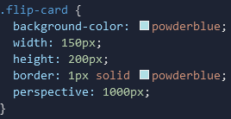
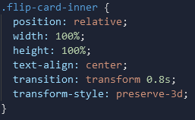

Style.css | Flip-card
Flip Card & Flip Card Inner
Flip Card On Hover Effect

Slide 6


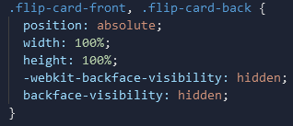
Style.css | Flip Card Front & Back
Front
Back
Positioning of Both

Slide 7
HTML Structure
<div class = "row">
<!--First column-->
<div class = "column">
<!--first column, first card-->
<div class="flip-card">
<div class="flip-card-inner">
<div class="flip-card-front">
<img src="./card_images/card_background.png" alt="card back">
</div>
<div class="flip-card-back">
<img src = "./card_images/Club_10.png" alt="Club_10">
</div>
</div>
</div>
</div>
<!--Three more cards make up one row. Add 4 more cards for another.--> </div>

